Slide 1

Lending Club Loan Defaulters Predictions
Group 3
(Suman Adhikari, Andrew Twijukye, Sagar Maharjan )

Slide 2
introduction
The project is about lending club determine the risk of losing money while lending to customer using machine learning.
Goals:
Minimize final loses
Optimize loan approval decisions

Slide 3
Problem
Loan Defaults and Credit Risk
Investment Performance Optimization

Slide 4
APPROACH
Dataset Used
https://www.kaggle.com/code/faressayah/lending-club-loan-defaulters-prediction/input?select=lending_club_loan_two.csv
Data Exploration
Preprocessing the data
Model Selection
Model Evaluation
Optimization and Hyperparameter Tuning
Conclusion

Slide 5
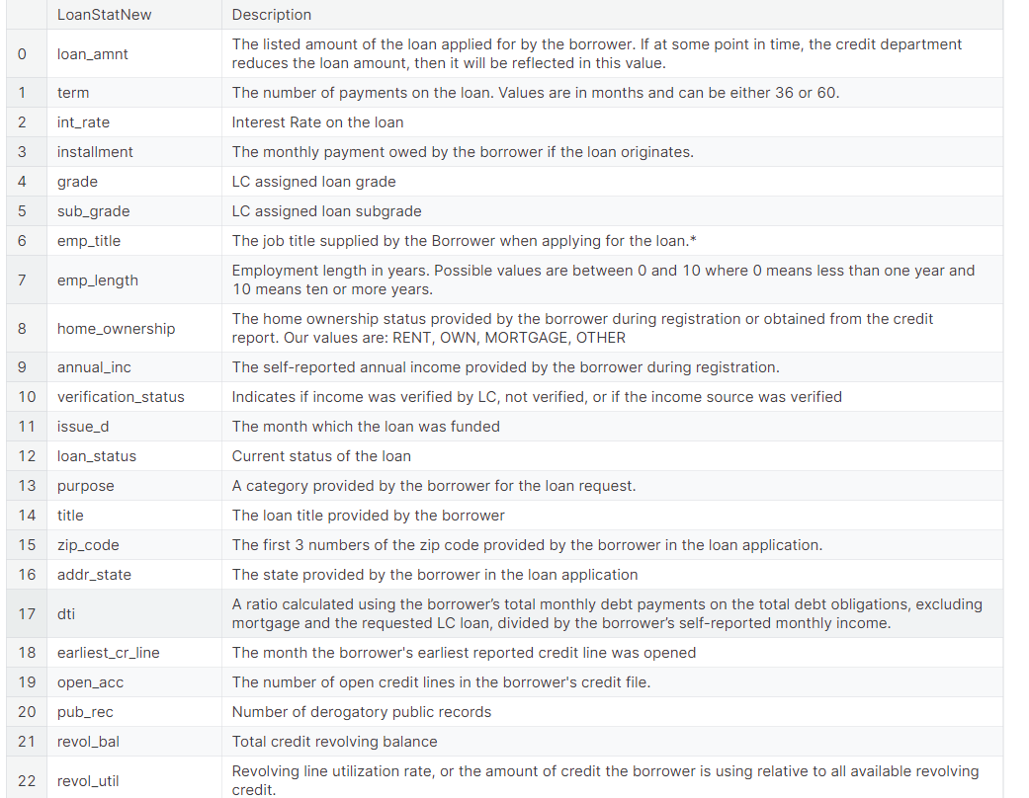
adf

Slide 6
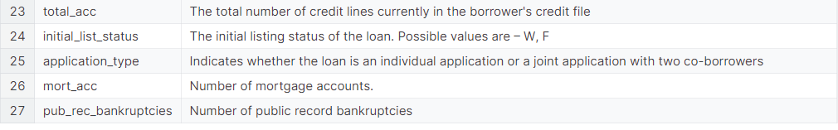

Slide 7
Data Exploration
Label Distribution(loan_status)
Plot histogram diagram for main features
Correlation Matrix
Percentage of Missing Value
Outliers found in each features
Count of unique value in categorical features

Slide 8
DATA PREPROCESSING
Impute Missing Values
Remove repeating and irrelevant features
Encode Categorical features into numerical format
Oversample the minority
Feature Engineering

Slide 9
MODEL SELECTIOn
Logistic Regression
Random Forest
XGBoost

Slide 10
Model Evaluation
Accuracy
Precision
Recall
F1Score

Slide 11
Optimization and HYperparameter TUnning
Grid Search

Slide 12
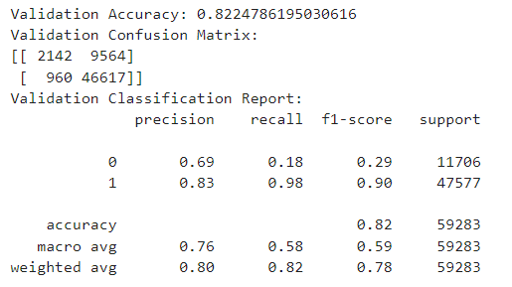
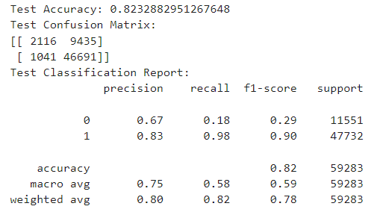
LOGISTIC Regression
Perfromance

Slide 13
DATA PREPROCESSING in detail
Impute Missing Values
mort_acc - imputed using Random Forest
Remove repeating and irrelevant features
Grade and sub_grade: grade is removed
Issue_d is dropped: trying to find if loan can be issued or not
Emp_title: dropped for having too little datapoints
Emp_length: as equal distribution for all values
Encode Categorical features into numerical format
Zip_code, purpose, home_ownership, sub_grade, loan_status – label encoded
Verification_status, initial_list_status, application_type – one hot encoded
Oversample the minority
Used Smote for handling oversampling issues
Feature Engineering
Zip_code is extracted from address

Slide 14
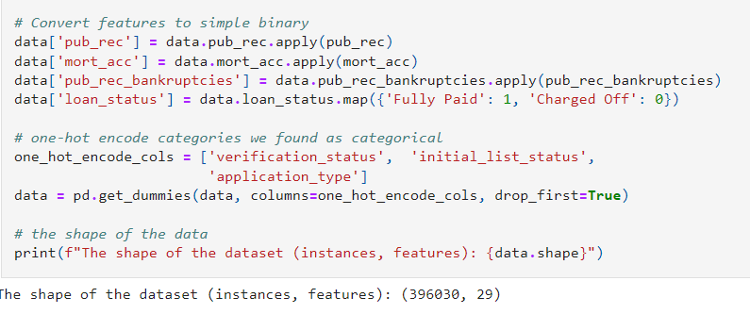
Data Preprocessing in Detail
Binary classification

Slide 15
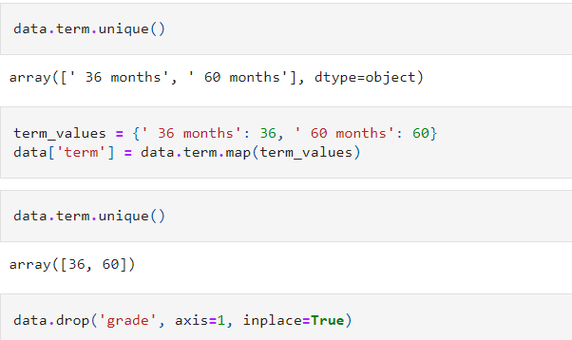
Data Preprocessing in Detail
Converting categorical string features into numerical formats

Slide 16
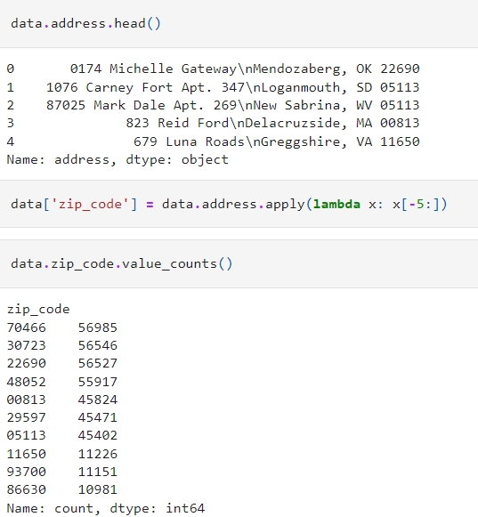
Data Preprocessing in Detail
Changing feature address to zip_code

Slide 17
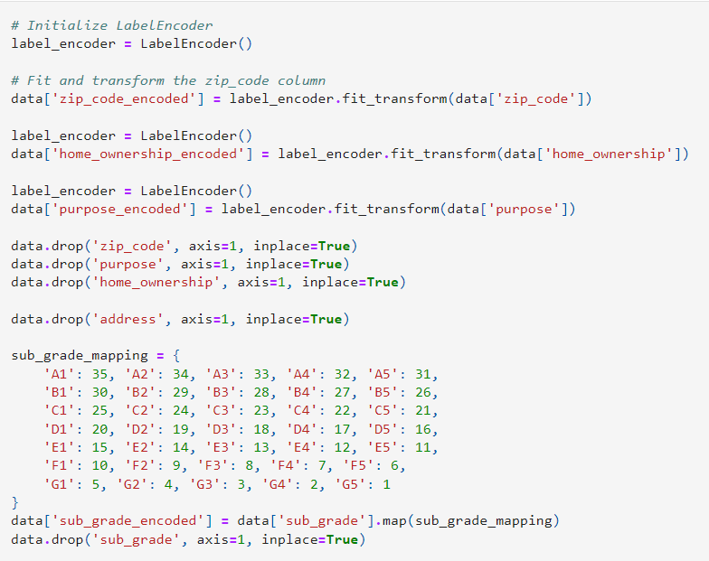
Data Preprocessing in Detail
Categorical Encoding using Label Encoding

Slide 18

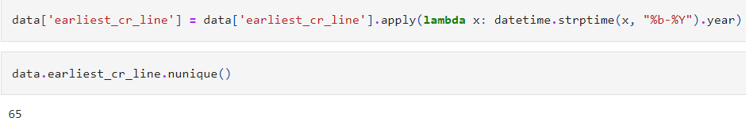
Data Preprocessing in Detail
Drop the features

Slide 19
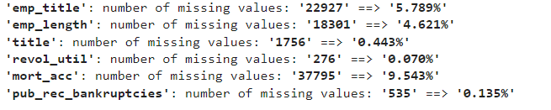
Data Preprocessing in Detail
Removing and imputing missing values

Slide 20
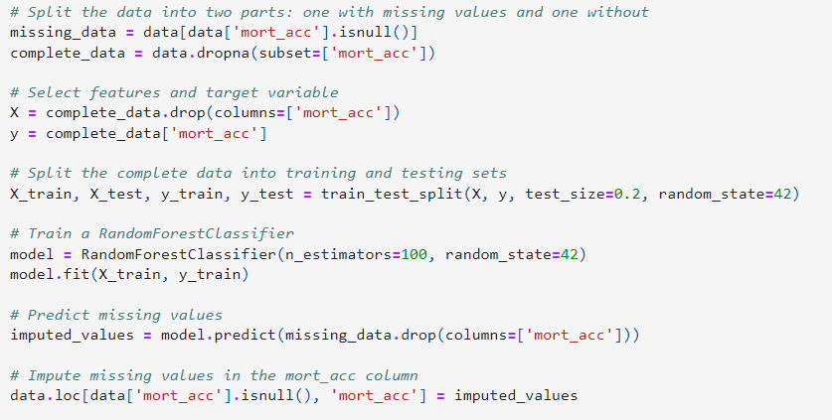
Data Preprocessing in Detail
Imputing feature mort_acc using Random Forest

Slide 21
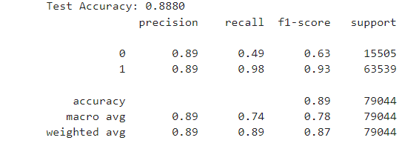
XGBoost Classifier
Performance:

Slide 22
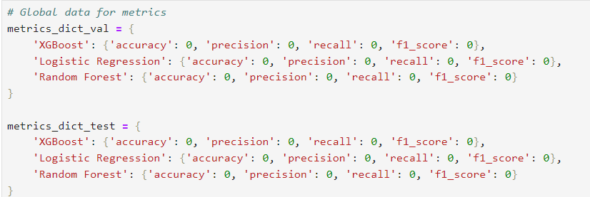
Metrics gathering and visualization
Add metrics collection and visualization for validation and test set

Slide 23
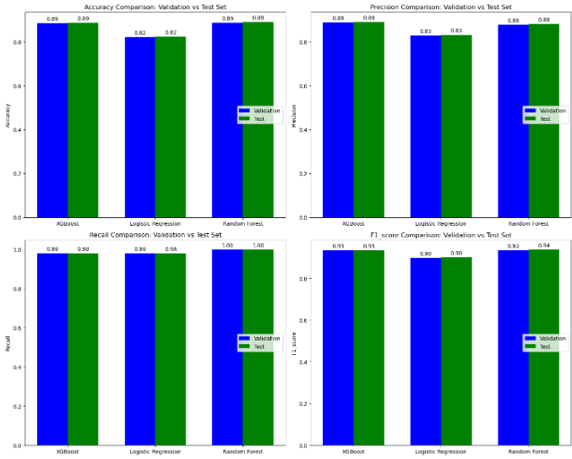
Metrics gathering and visualization
Add metrics collection and visualization for validation and test set

Slide 24
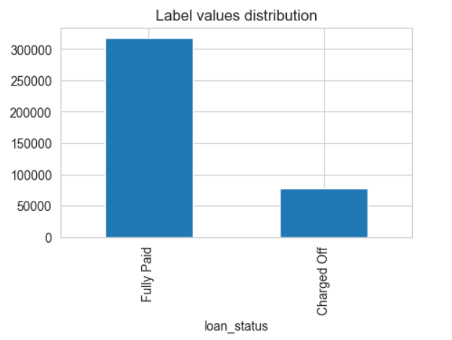
Data EXPLORATION IN DETAILS
Label distribution

Slide 25
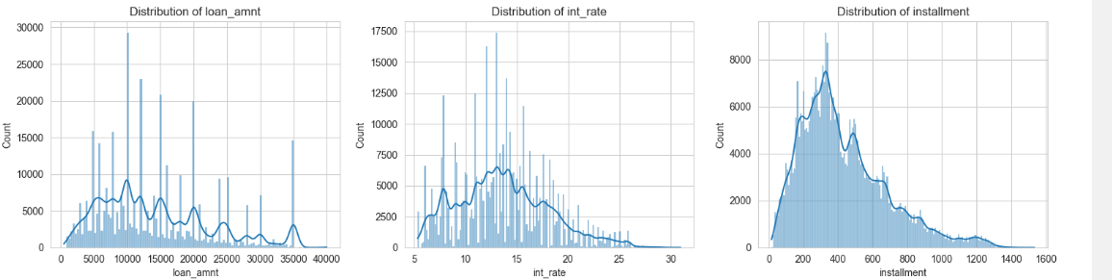
Data EXPLORATION IN DETAILS
Histogram

Slide 26
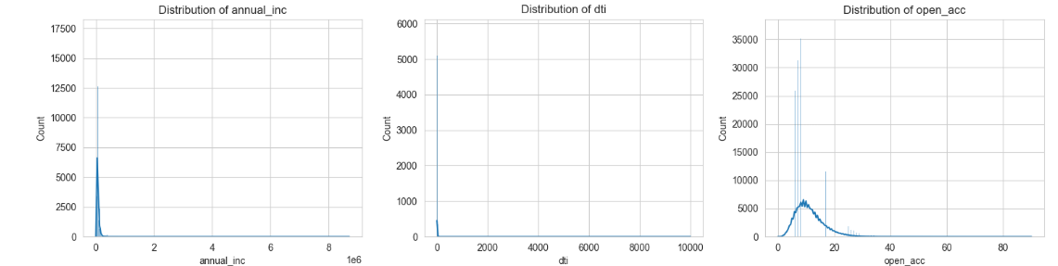
Data EXPLORATION IN DETAILS
Histogram

Slide 27
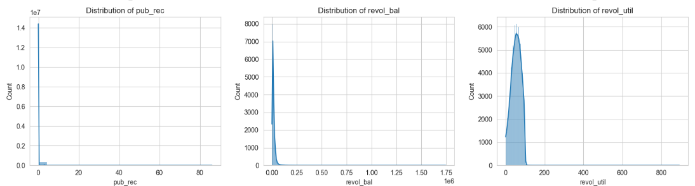
Data EXPLORATION IN DETAILS
Histogram

Slide 28
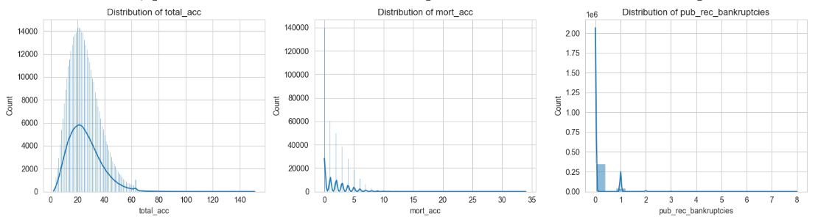
Data EXPLORATION IN DETAILS
Histogram

Slide 29
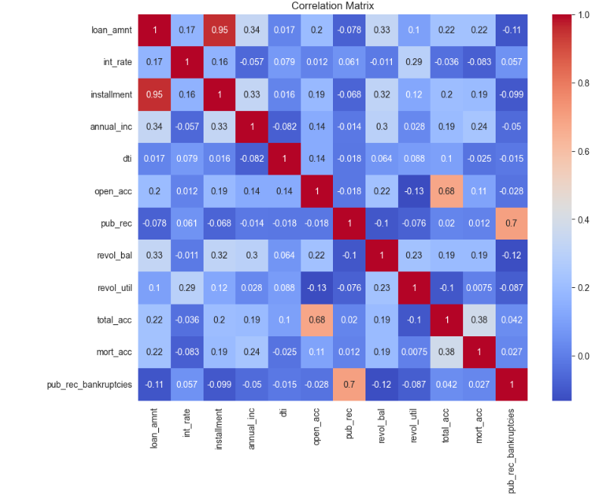
Data EXPLORATION IN DETAILS
Correlation Matrix

Slide 30
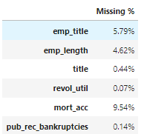
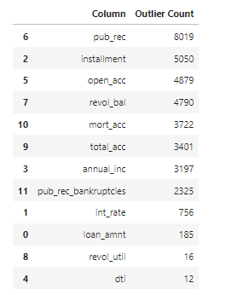
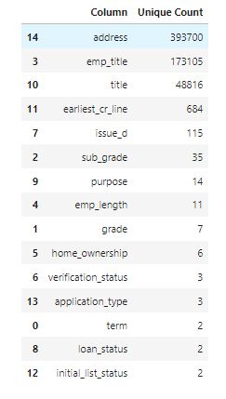
Data EXPLORATION IN DETAILS
Percentage of missing values
Outliers in each features and count of unique features in categorical features

Slide 31
Data EXPLORATION IN DETAILS
Preprocessing strategy
Addressing the imbalance
Handling skewness
Normalization/Standardization
Feature Engineering

Slide 32
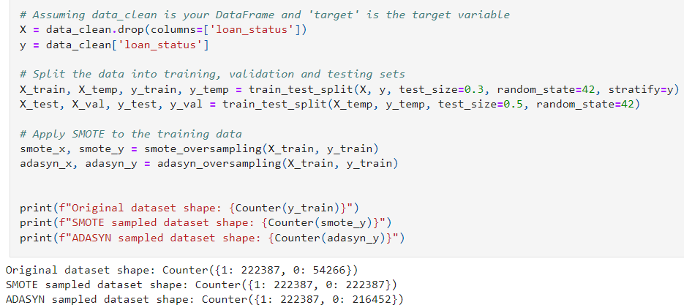
SMOTE AND ADASYN oversampling technique
Preprocessing strategy

Slide 33
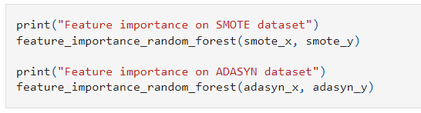
Feature importance analysis
Comparing between the SMOTE and ADASYN

Slide 34
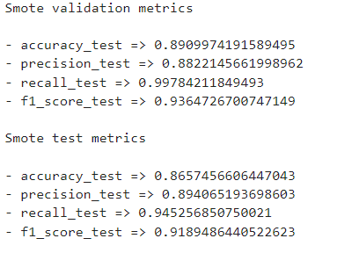
Random Forest Classifier
Data Exploration
Performance:

Slide 35
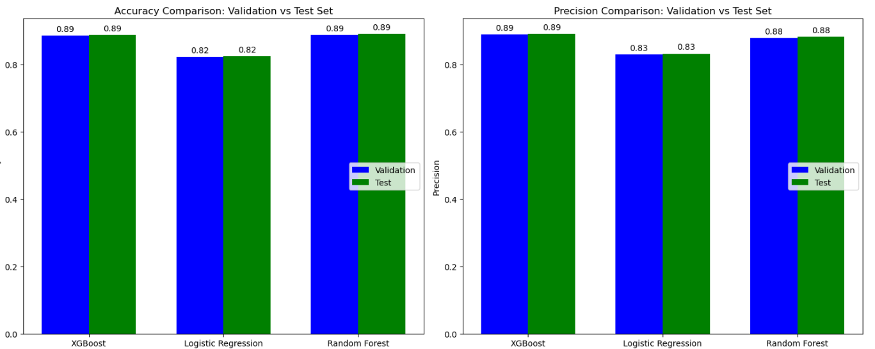
Results

Slide 36
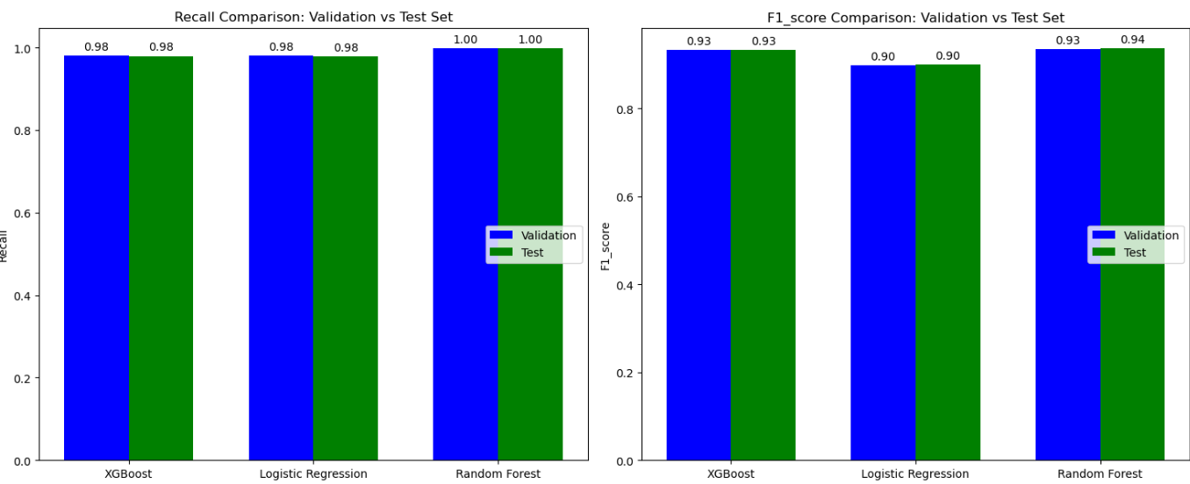
Results

Slide 37
ConCLusion
Successfully leveraged logistic regression, artificial neural networks, random forests, and XGBoost classifiers to address loan and credit risk assessment, significantly enhancing investment performance optimization.
The comparative analysis demonstrated that XGBoost outperformed other models in predictive accuracy and reliability, providing robust insights for informed decision-making in financial investments.

Slide 38

Thank you

